Slide 1
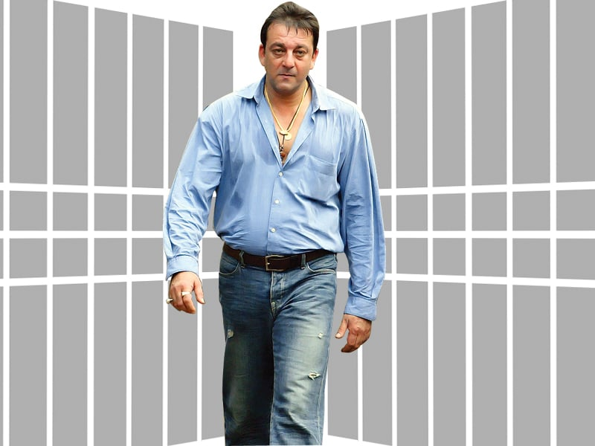
Guess the Person
My body count is slightly less than the total angle of a circle
Hum hai Yam, Yam hai Hum
In the Mumbai, all over India we are the Bhai’s
I am always ready for a Shootout
Cigratte is the least of my worries
Musafir hu Yaaron, Na Saki hai Na Sharab
Yere Yera Pausa, Tule Deto Paisa
Choli Ke Peeche Kya Hai, Choli Ke Peeche
Mene Yerwada me kaafi Din Bitaye Hai

Slide 2
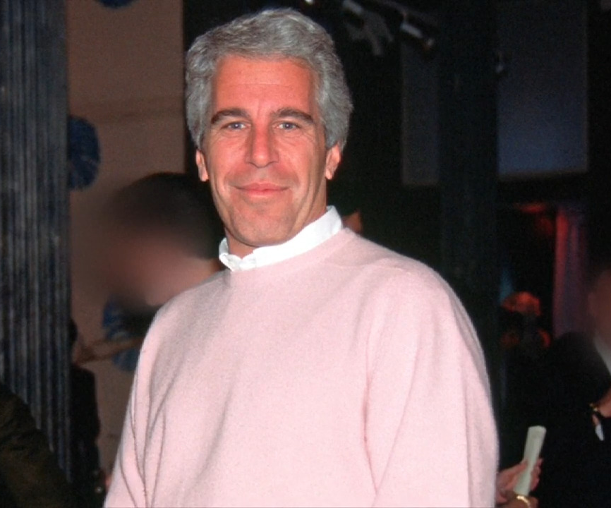
Guess the Person
Life Stage Rule is not applicable to me
I will be there for you, like I have been there before!
Chaaro tarah he mere hi charche, honthon par he sirf mera naam
I come along with Hawas ki Poojaran
I am a huge fan of Taare Zameer Par
Kaho na Pyaar Hai, Kaho na Pyaar Hai
I am a huge admirer of the TV show Lost
Zara Zara Touch Me, Zara Zara Hold Me

Slide 3

Guess the Person
Deklo idhar to ek baar, Main Hoon Na
Non-Chalant AF, Life Goals for so many
I am the Chilli and the Chingari
Ye Chori Badi Drama Queen Hai
Pardesiya ye Sach hai Piya, Sab kehte he mene tera Dil le lia
Plastic is my middle name
Main na khudki favorite hu, by God!
I never found my prince in the Swayamvar

Slide 4
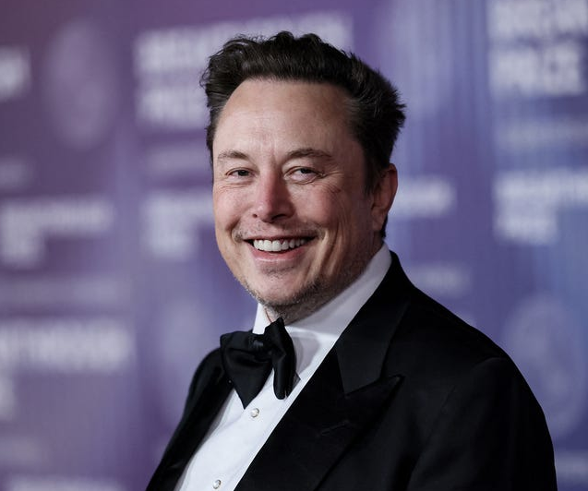
Guess the Person
Tu lutt ja Slowly Slowly
Richie Rich hu main
Dost Dost Na Rha, Yaar Yaar Na Rha
Salary is the least of my worries
Neele Neela Amber par Chand jab aaye
I can’t get over my ex!
Twinkle twinkle little star
Aaj truck tera bhai chalayega
I am RocketSingh, salesman of the year

Slide 5
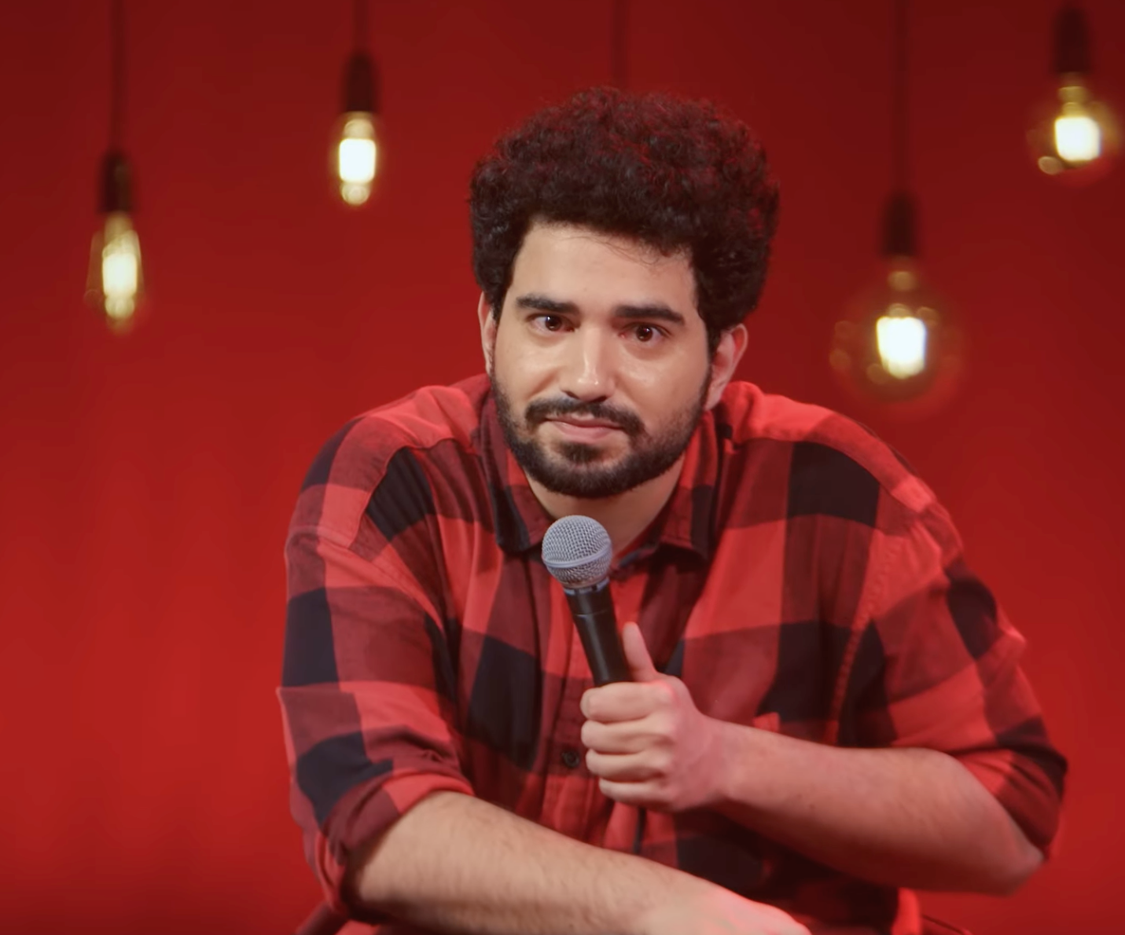
Guess the Person
Tera Yaar Hu Main.....
Paint it Red! Ik Junoon, Ik Deewangi
Embarrasment is afraid of me
But Pappu Can’t Dance Saala
Coca Cola: Open Happiness
Zinda hu yaar! Kaafi He
Checkmate!
I am not huge fan of biographies
Jinke Ghar Shishe ke Hote he, Woh Basement me Kapde Badalte he

Slide 6
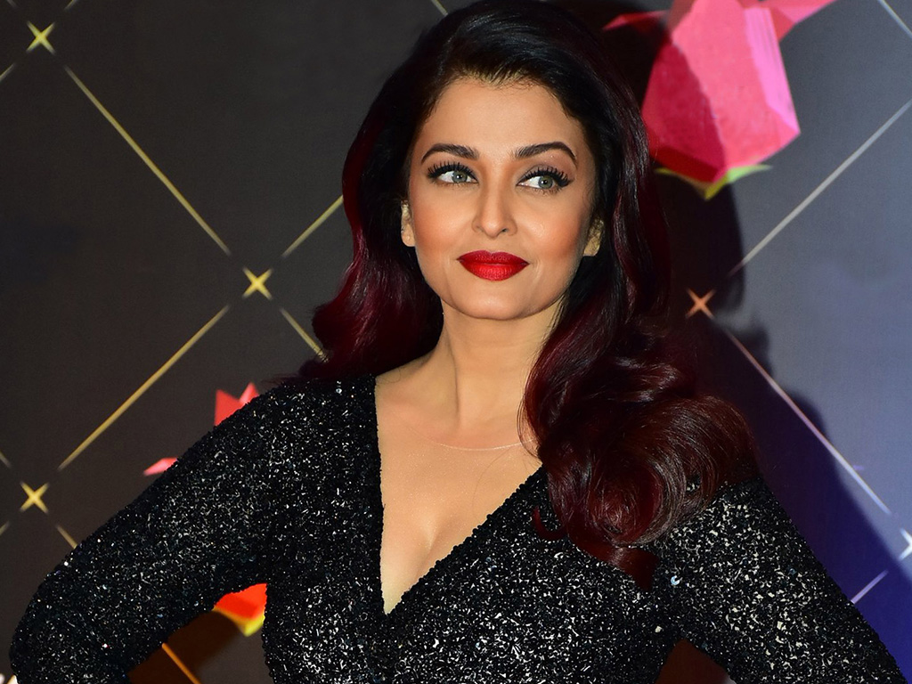
Guess the Person
Back to the Future
My life is a MCQ, always having to choose beween two
5 samasya 1 samadhaan
Silent ho jao, warna me violent ho jauga
I am not a robot, I am a human being
Dil Dooba, Dil Dooba, Nili Aankhon me ye Dil Dooba
I instantly own the room, I enter in
Pati, Patni aur Woh

Slide 7
Nayak nhi Khalnayak hu me
I created Love Island long before Netflix
Shesh Naag, Don Tond
I stole the blueprints of Tarzan the Wondercar
Kashmir me tu KanyaKumari
Hum bhi he Josh Main

